Slide 1
Computer Vision

Slide 2
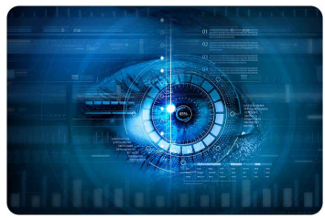
WHAT IS COMPUTER VISION?
COMPUTER VISION IS WHEN A COMPUTER AND/OR MACHINE HAS SIGHT

Slide 3
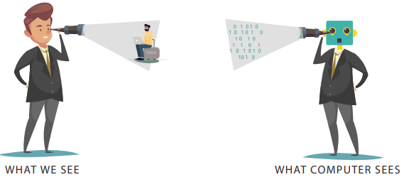
HUMAN VISION VS COMPUTER VISION

Slide 4
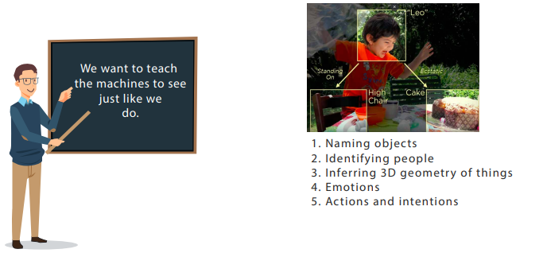
Goals of computer vision

Slide 5
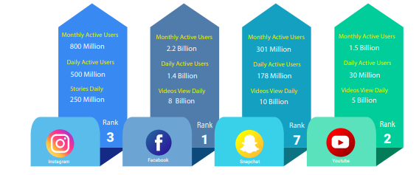
WHY DO WE NEED COMPUTER VISION?
Photos and videos are becoming an integral part of human life

Slide 6
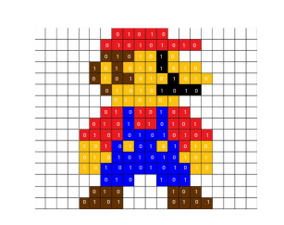
IMAGES ARE PLAIN NUMBERS
Images are three dimensional array of numbers known as pixels, but these do not carry any meaning in themselves.

Slide 7
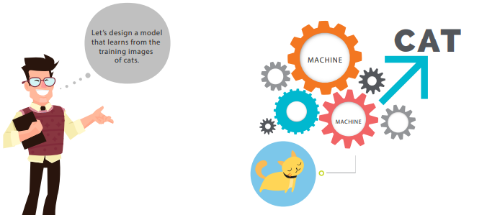
HOW DOES COMPUTER VISION WORK?

Slide 8
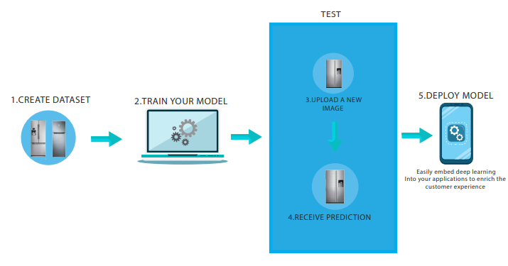
COMPUTER VISION WORK FLOW

Slide 9
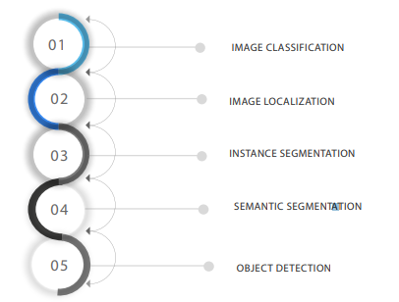
COMPUTER VISION TASKS

Slide 10
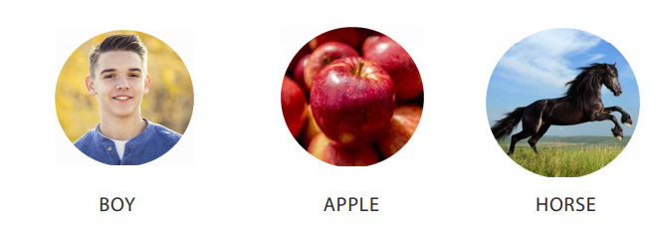
IMAGE CLASSIFICATION

Slide 11
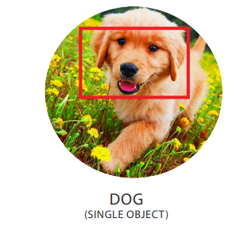
IMAGE LOCALIZATION

Slide 12
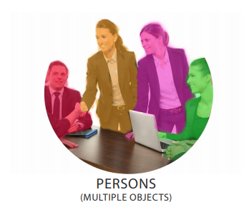
INSTANCE SEGMENTATION

Slide 13
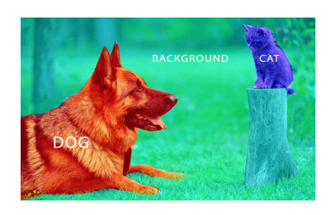
SEMANTIC SEGMENTATION

Slide 14
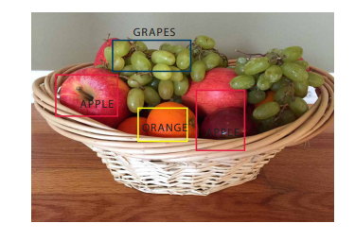
OBJECT DETECTION

Slide 15
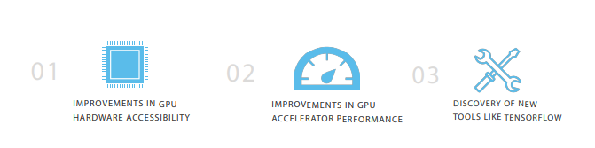
COMPUTATIONAL POWER
TODAY, COMPUTERS CAN ANALYZE AND UNDERSTAND IMAGE DATA BET TER AND FASTER THAN EVER BEFORE

Slide 16
What is Image Processing?
Image processing is a method to convert an image into digital form and perform some operations on it, in order to get an enhanced image or to extract some useful information from it.

Slide 17
What is Image Processing?
It is a type of signal dispensation in which input is image, like video frame or photograph and output may be image or characteristics associated with that image. Usually Image Processing system includes treating images as two dimensional signals while applying already set signal processing methods to them.

Slide 18
Image Enhancement
The purpose of the principle of image enhancement technology is to process an image so that the resulting image is more suitable than the original for a particular application. Most of the improvement methods are very problem-oriented and so an improvement for an application may prove to be destructive the other.

Slide 19
Purpose of Image processing
The purpose of image processing is divided into 5 groups. They are:
1. Visualization - Observe the objects that are not visible.
2. Image sharpening and restoration - To create a better image.
3. Image retrieval - Seek for the image of interest.
4. Measurement of pattern – Measures various objects in an image.
5. Image Recognition – Distinguish the objects in an image.

Slide 20
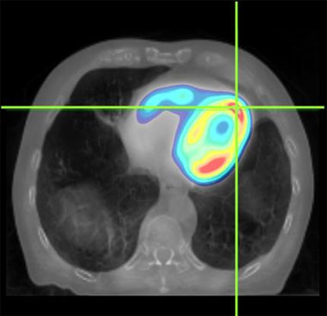
Medical
X-rays, ultrasonic scanning
Electron micro-graphs
Magnetic Resonance Imaging
Nuclear Magnetic Resonance Tomography

Slide 21
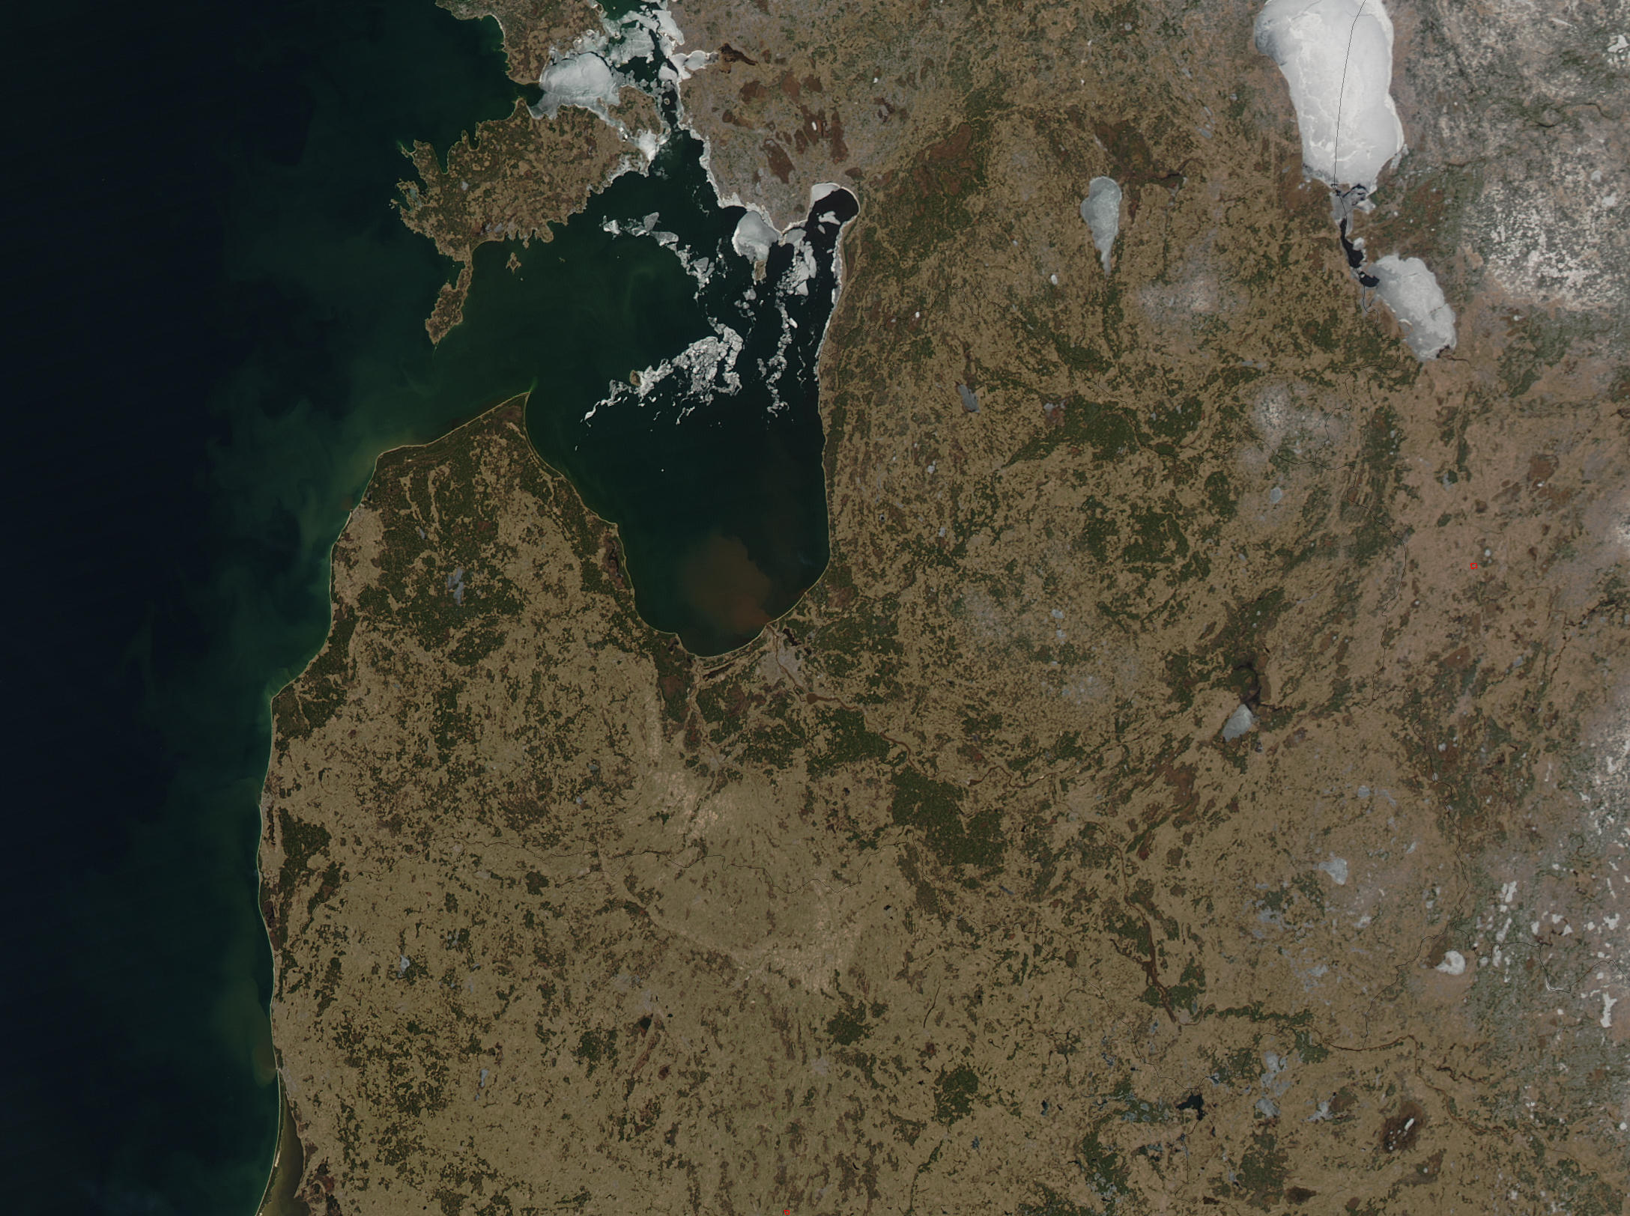
Satellite Images
Tracking ground resources
Geographic mapping
Prediction of arable crops
Urban populations
Weather prediction
Flood and fire protection

Slide 22

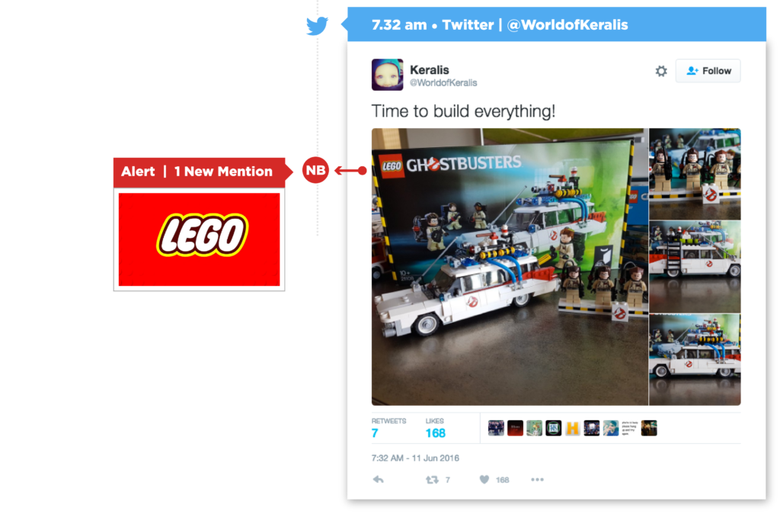
Brand Analysis

Slide 23
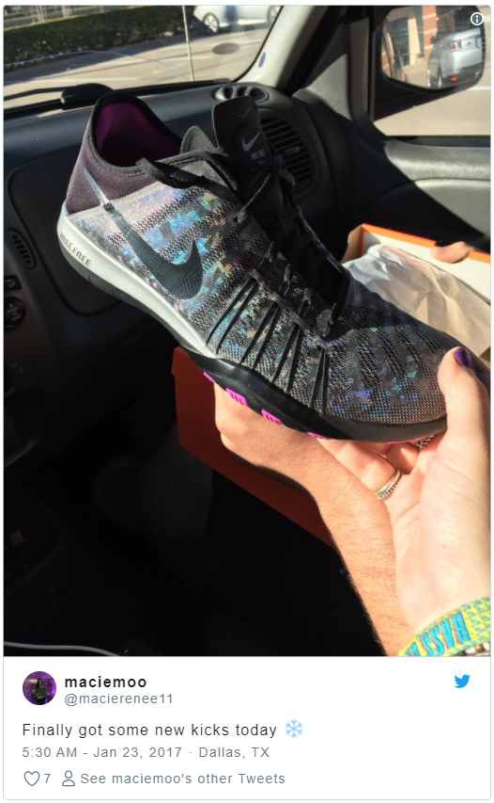

Track Brand Mentions More Accurately

Slide 24

Measure Sponsorship ROI
Logo recognition technology allows you to quantify the number of impressions and exposure that your brand is getting from something like a red carpet sponsorship. Otherwise, you have no way to track those visual-only mentions.

Slide 25

Identify Moments of Consumption
Every company wants know as much as possible about how, when, and where people are using their products, but the limits of text analysis can’t provide a complete picture of actual product use. Unlike text, images provide visual validation of the who, where, and how people are using your product. Without image analysis, your fans and customers have to specifically mention your product, which is less likely to happen.

Slide 26
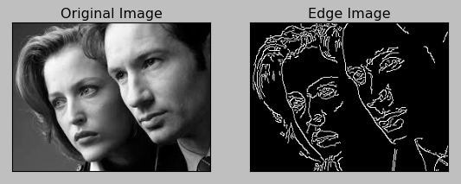
Edge Detection

Slide 27
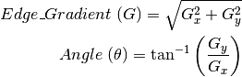
Edge Detection
Noise Reduction
Finding Intensity Gradient of the Image
Non-maximum Suppression
Hysteresis Thresholding

Slide 28
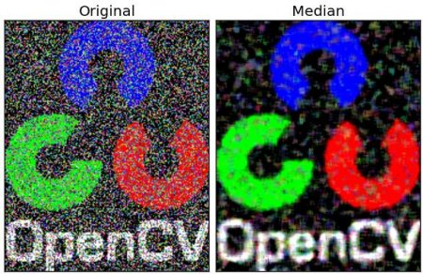
Median Filtering
Here, the function cv2.medianBlur() computes the median of all the pixels under the kernel window and the central pixel is replaced with this median value. This is highly effective in removing salt-and-pepper noise

Slide 29
Erosion
The basic idea of erosion is just like soil erosion only, it erodes away the boundaries of foreground object (Always try to keep foreground in white).
The kernel slides through the image (as in 2D convolution). A pixel in the original image (either 1 or 0) will be considered 1 only if all the pixels under the kernel is 1, otherwise it is eroded (made to zero).

Slide 30
Dilation
It is just opposite of erosion. Here, a pixel element is ‘1’ if atleast one pixel under the kernel is ‘1’. So it increases the white region in the image or size of foreground object increases. Normally, in cases like noise removal, erosion is followed by dilation. Because, erosion removes white noises, but it also shrinks our object. So we dilate it. Since noise is gone, they won’t come back, but our object area increases. It is also useful in joining broken parts of an object.

Slide 31
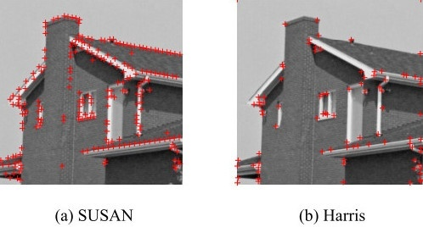
Corner Detection

Slide 32
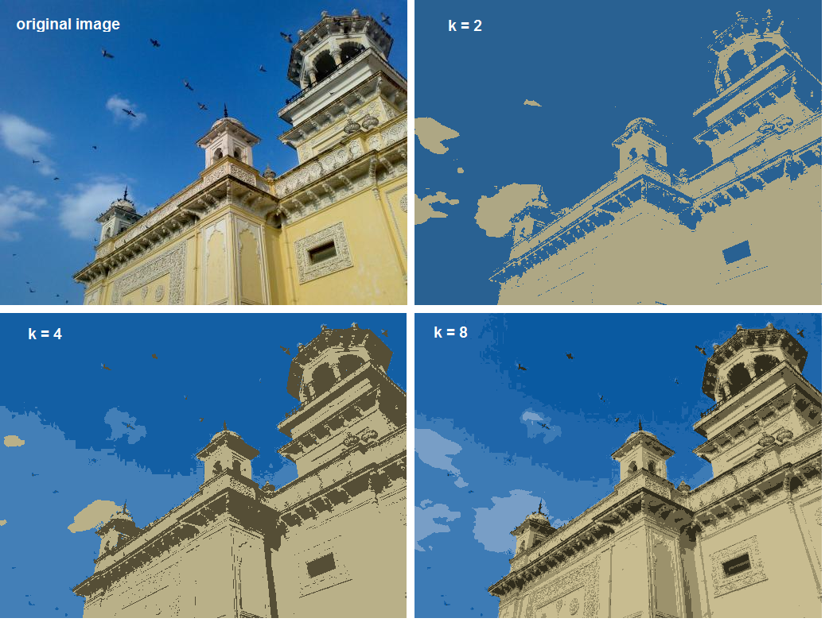
Color Quantization

Slide 33
Getting started with Images – Read an image
Use the function cv2.imread() to read an image. The image should be in the working directory or a full path of image should be given.
import numpy as np
import cv2
# Load an color image in grayscale
img = cv2.imread('messi5.jpg’,0)
# Second Argument – 0 for grayscale and 1 for color

Slide 34
Getting started with Images – Display an image
Use the function cv2.imshow() to display an image in a window. The window automatically fits to the image size.
# cv2.waitKey() accepts time in milliseconds.
# If you press any key in specified time, the program continues.
# If 0 is passed, it waits indefinitely for a key stroke.
# cv2.destroyAllWindows() destroys all the windows we created.
cv2.imshow('image',img)
cv2.waitKey(0)
cv2.destroyAllWindows()

Slide 35
Getting started with Images – Write an image
Use the function cv2.imwrite() to save an image.
# save an image in png format, you can also use other format
cv2.imwrite('messigray.png',img)

Slide 36
Getting started with Images – Using Matplotlib
Use the function cv2.imread() to read an image. The image should be in the working directory or a full path of image should be given.
import cv2
from matplotlib import pyplot as plt
# Load an color image in grayscale
img = cv2.imread('messi5.jpg’,0)
plt.imshow(img, cmap = 'gray', interpolation = 'bicubic’)
# to hide tick values on X and Y axis
plt.xticks([]), plt.yticks([])
plt.show()

